Slide 1
The Family Names of the UK project: retrospect and prospect
Richard Coates
University of the West of England, Bristol
Moscow City Pedagogic University, 19 September 2019

Slide 2
Abstract: Background to the FaNUK project
The Family Names of the United Kingdom (FaNUK) project database was delivered to Oxford University Press in June 2014 was published both online, in e-book form and in print in November 2016 as The Oxford dictionary of Family Names in Britain and Ireland (ODFaNBI). I offer some reflections on the process of creating a resource of this kind, including an assessment of methodological and factual advances that have been achieved and an outline of some possible directions for future research. Many questions have arisen about the reliability and utility of sources of data, and programmatic answers are offered for some whilst acknowledging the emergence of new ones and the persistence of others. Progress has been made in understanding the origin of many surnames, and some specimens will be fully discussed illustrating either philological or methodological novelties. Some names have continued to defy explanation, and some of the broader questions that these raise are explored. Work is still in progress towards a concise form of the dictionary and an eventual second edition!

Slide 3
Definition of surname or family name
These terms are roughly equivalent but not quite – in UK today every individual has a surname, which is not necessarily shared by all members of a family, so some families don’t have a family name
Surnames (“additional names”) in England began in a big way in the early Middle Ages (12th/13th century), in order to differentiate for legal reasons the many MEN who bore the same given name (Richard, Henry, William …)
Surnames were generally descriptive of the bearer, relating to their place of birth or residence (York; Bristow), occupation (Baker; Smith), family or social status (Johnson; King) or physical/moral characteristics (Little; Black; Pennyfather), and they could be fluid
The term surname is generally used when such names become hereditary, i.e. when they are not necessarily truly descriptive of the bearer
Use of hereditary surnames spread from the aristocracy down the social scale, until by the 16th century most English people had a settled surname (but later in some remote areas, esp. northern England, and also in Wales)

Slide 4
What is a UK surname/family name?
Data from recent electoral rolls and censuses shows that there are 378,782 different surnames, or names that are treated as surnames, in the UK today. However, over 300,000 of these are the names of recent immigrants, while another 30,000 are long-established but rare. 14,452 had fewer than 100 bearers in 1997, but had more than 20 bearers each in the 1881 census.

Slide 5
The “main task” in its context (1)
There are over 45,000 surnames that are both long-established and fairly frequent (i.e. they each have more than 100 bearers today)

Slide 6
The “main task” in its context (2) Recent immigrant names: some facts
Many of the 45,000 originate outside the UK.
The 32nd most common name in Britain today is Patel, with over 95,000 bearers.
There are over 200,000 immigrants from China in Britain today. Between them they have only about 200 surnames, and these are almost all of high frequency in Britain. Most of these names, are informal and varying anglicizations of Cantonese forms (from Hong Kong).
Lee is a well-known, well-established traditional English name, but nearly half the 84,000 bearers of this surname in present-day Britain are of Chinese ancestry.
There are over 30,000 bearers in Britain of the Arabic name Muhammad in various spellings, reflecting not only Arabic-speaking but also (in different spellings) Pakistani, Bangladeshi, Indian, Iranian, Turkish, Malaysian, and other immigrants. Most people of Pakistani heritage in Britain bear names of Arabic etymology (because Muslim).
Many other names of Arabic etymology have Muslim religious associations. But not all names with an Arabic etymology are Muslim. There are Christian Arabs in Britain bearing names such as Is(s)a, and there are Sephardic Jewish names of Arabic etymology (some instances of Abbas).

Slide 7
Immigrant names in more detail (!)
Norman!
Scottish, Irish, Manx!
Huguenot (!?)
Jewish and Central European, Italian
Empire: Indian, Chinese [Hong Kong, Singapore], Nigerian
West Indian
Post-imperial: Arabic/Muslim, European Union

Slide 8
Why FaNUK?
Why was the project needed?
How did we go about performing the task?

Slide 9
Reaney’s dictionary
The previous most authoritative resource is based on work done over 60 years ago:
P. H. Reaney’s Dictionary of English Surnames (1958, with revisions by R. M. Wilson in 1976 and 1991)
It is incomplete, despite being over 500 pages long; comparison with 1881 census data reveals the omission of some quite frequent names such as Alderson (northern English), Critchley (Lancashire), Liptrot (Lancashire), Perks (West Midlands), Pringle (Northumberland), Sneddon (Dumfriesshire), Verrall (Sussex), and over 20,000 others with more than 100 modern bearers.
It is essentially a dictionary of surnames of Middle English origin.

Slide 10
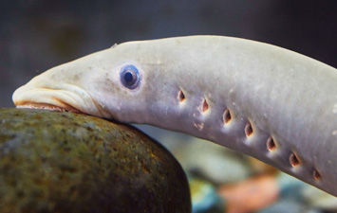
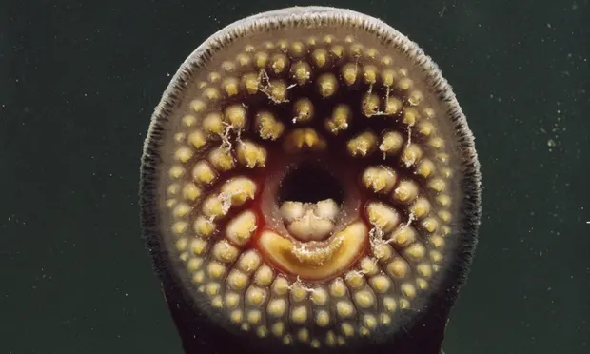
Included in Reaney, 3rd edn: surnames which are now extinct
Burstler (occupational name for a make of things with bristles)
Chaucer ((French) occupational name for a maker of leg-coverings)
Grithman (nickname for someone who has taken sanctuary)
Hagtharp (from a place-name in Westmorland)
Hastvillain ((French) nickname, = ‘hurry the peasant up’)
Illbode (nickname, = ‘evil messenger’, ‘bringer of bad news’)
Jubber (= ‘maker of jubbes’, containers for liquor)
Lampreye (perhaps for a seller of lampreys, or perhaps a nickname)
Malhead ((partly French) nickname, = ‘head like a hammer’)
Mousebeard (nickname); Pillock (nickname, = ‘penis’); Slabbard ((Dutch) nickname, = ‘slow-witted’)
Twyer ((French) occupational term for a furnaceman); Upholder (occupational name for a seller of second-hand goods)
Notes:
минога

Slide 11
Reaney can be systematically misleading
Ravenshaw, Ravenshear, Ramshaw, Ramshire, Ranshaw, Renshaw, Renshall, Renshell. … ‘Dweller by the raven wood’ as at Ravenshaw (Warwicks) or Renishaw (Derbys).
Such names are practically always from a place-name rather than from a place-description.
NB this set also illustrates one of the biggest problems in English anthroponymy: the existence of numerous variants – spelling and pronunciation and their relations.

Slide 12
Variants
For example:
Garrett + 36 variants
Caldicott + 27 variants
Birkinshaw + 22 variants (incl. Brokenshire)
Xu + 24 variants (Mandarin, Cantonese, Hokkien, Taiwanese … + different systems of Romanization (Xu, Hsu …)

Slide 13
Conversely: there are names with many explanations
Holland 11
Chung 11
Ching 12
Tong 12
Kan 12
Chin 15
Yan 15
Chu 19
Yu 20
Chi 27

Slide 14
Time for a new dictionary! What could a surname project do? (1)
Philology
Demography (esp. concentrating on social status)
Genetics
Psychology

Slide 15
We had a decision to make: Is our goal to work forwards or work backwards?
Is it, as in Reaney’s dictionary, to be philologists, and prioritize the medieval material, only some of which is of present-day relevance?
Or is it to explain modern surnames, a large number of which (over 20,000, we estimated, or almost half of the 45,000 which we identified as the core target) have not yet been properly explained linguistically?
We chose the second option.

Slide 16
What can a surname project do? (2)
Offering greater accuracy, because there are errors or incompletenesses in Reaney – for example Clutterbuck, Cullabine, Gaukroger, Twelftree
Offering more documentary evidence, medieval and modern, for the etymologies proposed, and to provide secure links between medieval and modern evidence
Focused on the situation in the 21st century – a dictionary of modern surnames
More comprehensive, including also names of recent immigrant origin

Slide 17
Project staff
Patrick Hanks, lead researcher and chief editor
Paul Cullen, research associate
Simon Draper, research associate
† Duncan Probert, research associate
Adam Rambousek, computational linguist and lexicographical database manager
Harry Parkin, research student and later research associate
Kate Hardcastle, editorial research assistant
Debbie Cole, project administrator
Richard Coates, principal investigator

Slide 18
Contributory helpers
Providing, or commenting on, a vast number of pieces of evidence:
Church of Jesus Christ of Latter-Day Saints (‘The Mormons’)
Federation of Family History Societies
Guild of One-Name Studies
A range of consultants on individual languages, notably Peter McClure on Middle English, that language of the primary surnaming period

Slide 19
Summary of the scope of the project
To explain etymologically (with due regard for geography and history) all of those just under 46,000 names which had more than 100 bearers in 1881 or 1997, including all post-1881 immigrant names which meet that criterion >>> reserve dbs
These cluster into 19,000+ groups, with about 27,000 treated as etymological (mainly spelling-)variants of main entries

Slide 20
The basic data of FaNUK
Collection and analysis of data. For surnames, this implies the assembly in databases of vast numbers of records, both medieval and modern, and/or access to online accessible records, and their cautious and selective admission to the FaNUK research database.
In recent years we have seen the benefits of numerical analysis and mapping of the surnames of the 1881 census and of data relating to more recent electoral rolls by researchers such as Steve Archer and Richard Webber.

Slide 21
Archer’s mapping of the 1881 Census data: Devereux per 10,000

Slide 22
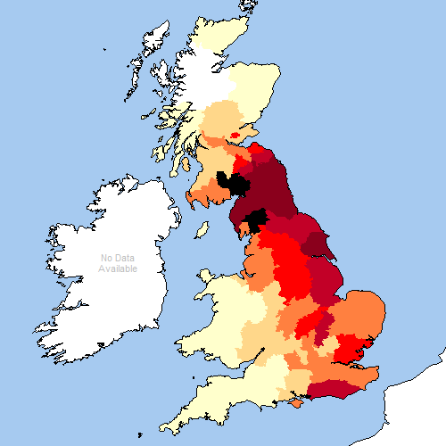
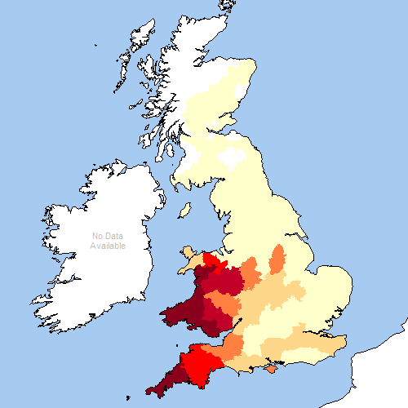
Archer’s mapping of the 1881 Census data: Relationship names Richard, Richards, Richardson

Slide 23
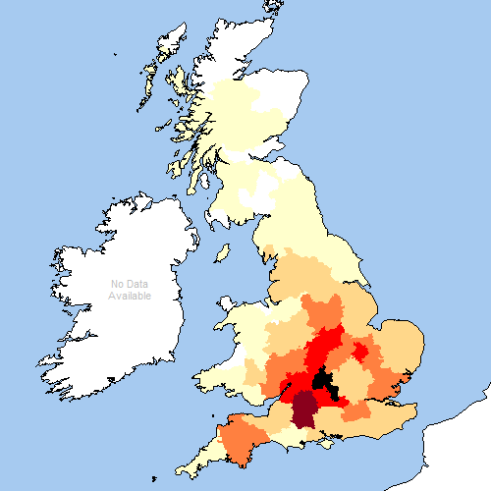
Archer’s mapping of the 1881 Census data: Townsend absolute and per 10,000

Slide 24
Another major source of data
International Genealogical Index (IGI) of Family Search International, the genealogical project of the Church of Jesus Christ of Latter-Day Saints.

Slide 25
Problems of procedure
Lexicographical: which to choose as a head-form?
Ravenshaw, Ravenshear, Ramshaw, Ramshire, Ranshaw, Renshaw, Renshall, Renshell
Nearest to the etymological source? [May be rarer than other derivatives. Sometimes extinct.]
Most frequent? [In which year? 1881 or 1997?]

Slide 26
Summary of the principles of the FaNUK Project (1)
We needed to encourage the large-scale digitization of source documents so that the data in them can serve as a quarry for statistical evaluation in the search for explanations. We have begun this task, with the help of a recent grant from the British Academy, to index the surname material in Carolyn Fenwick’s edition of the late 14th-century Poll Taxes, an important resource dating from just before a period where the documentary record becomes thin and fragmented before its resurgence in the Tudor period (1485-1603), and we have pursued the possibility of further digitizations with Britain’s leading archives. We have worked with The National Archives (TNA) in London to access digitized versions of probate records, and of the 15th-century chancery proceedings which provide a crucial bridge in a period poor in documentation. Family Search International has allowed us access to the data in the International Genealogical Index.
We needed to scrutinize the findings and hypotheses of previous researchers to clarify defective explanations where possible, fill in gaps, and show continuity from the period of surname formation (whenever that may be deemed to end) to the present day, using wherever possible data supplied by family historians, an important constituency among the end-users of the dictionary.
The correlation between surnames and localities had to be investigated, using computational and statistical techniques, not only on the basis of recent data and the 1881 census, but also, as far as possible, historically. This implies using other resources such as IGI and anything else that is available in machine-readable form, and exploring mapping techniques such as those used by Steve Archer.

Slide 27
Summary of the principles of the FaNUK Project (2)
The database contains entries for all names that are current in present-day Britain, including recent immigrant names, down to an agreed frequency threshold (all surnames with more than 100 bearers in a recent census, plus names which have been explained incorrectly in previous dictionaries). If all attempts to explain a name failed it was registered in the dictionary as ‘unexplained’, rather than ignored.
Equal attention was given to names of Irish, Scottish, Welsh, Cornish and Manx origin. Reaney got many of these badly wrong. With the support of leading scholars as consultants in these areas, we did better.
We co-operated with key members of the genealogical research community.
Explanations were written in clear readable English, and presentation was improved. The telegraphic style of Reaney, with stacked lists of data surrounded by heavy abbreviation of sources) was not felt to be a good model.

Slide 28
A Reaney entry
HEANE, HEANES: Robert Hene 1275 RH (L); Robert Heanes 1655, Hene 1660, Heaines 1669 LeiAS 23. OE hēan ‘poor, wretched’.
Essentially for academic consumption, but placed in public libraries.

Slide 29
Our vision of how it could be improved
Heane
Frequencies: GB 1881: 109, GB 1997: 82, GB 2011: 83, Ireland 1911: 8, Ireland 1997: 1 main GB location, 1881: Lincs and E Midlands; Surrey Variants: Hean, Heanes.
language/culture: English Nickname: from Middle English hen(e), heine ‘poor, needy, wretched’ (Old English hēan). arly Bearers: Robert Hene, 1275 in Hundred Rolls (Lincs); Johannes Heen, 1379 in Poll Tax (Clapham, Sussex); William Heyne, 1447 in Feet of Fines (Oxon); Edward Heane, 1543 in IGI (Longford, Derbys); Thomas Hene, 1559 in IGI (Penrith, Cumb); John Hean, 1673, John Heane, 1675 in IGI (Kirk Ireton, Derbys).
Hean
Frequencies: GB 1881: 91, GB 1997: 19, GB 2011: 12. main GB location, 1881: Angus; London
language/culture: Scottish, English see Heane.
Heanes
Frequencies: GB 1881: 52, GB 1997: 93, GB 2011: 95. main GB location, 1881: Lincs; Middx
language/culture: English variant of Heane with post-medieval excrescent -s. Early Bearers: Richard Henes, 1560 in IGI (Baston, Lincs); John Heanes, 1574 in IGI (Billingborough, Lincs); Luse Eanes, 1629 in IGI (Chester, Cheshire); Robert Heanes, 1655, Robert Hene, 1660, Heaines, 1669 in Leics Transactions 23; Thomas Heans, 1652 in IGI (Long Bennington, Lincs); Elizabeth Eanes, 1806 in IGI (Tichborne, Hants).

Slide 30
Local history
The works of local history scholars such as David Hey and George Redmonds have shown that, for a significant number of unusual names, intensive local research or one-name research is required, and turns out to be fruitful.
Surnames tend to cluster near their place of origin.

Slide 31
Some findings in detail (1) – Peter McClure
Waterer, for which Reaney cites only one early bearer, Richard Waterer, 1443, from a Sussex court roll. He explains it as an occupational term for one who irrigated land or who led cattle to water. There is sixteenth-century evidence from Woking in Surrey that the surname Waterer was an alias of Atwater. The surname is not occupational but topographical, denoting someone who lived by a stretch of water, the village pond, perhaps, or a stream or river. This type of topographic surname ending in -er, such as Felder ‘dweller by the field’ and Forder ‘dweller by the ford’, was first identified by Gustav Fransson in 1935. He noted that they were common only in the South, where they are found in abundance in the fifteenth and sixteenth centuries, and that most instances had been found in Sussex, Hampshire and Surrey.
Waterer might sometimes have been occupational, particularly if it occurs in significant numbers in the midlands and north, but it doesn’t. Archer’s map for the 1881 Census records 187 persons bearing the name, 179 of them in the southern counties, 109 in Surrey alone. The IGI gives a similar picture. Of 1,133 entries, 656 are in Surrey parishes from the mid-1500s onwards and 190 are in Greater London (most of it former Middlesex). Only 83 are in Sussex (from the mid-1500s), and the rest appear in much smaller numbers in other counties, mostly southern and mostly eighteenth- and nineteenth-century.
The Woking data was published in Nomina in 1982, but Reaney’s explanation remains unmodified in Wilson’s revision of 1991. Cottle’s explanation is unaltered in Titford’s revision of the Penguin dictionary in 2009. In fact very little of the research on surnames published after 1958 has found its way into any of the dictionaries that succeeded Reaney’s own first edition. It was one of FaNUK’s intentions to remedy this, and this deficiency was a major incentive to set up the project in the first place.

Slide 32
Some findings in detail (2)
Reaney’s entry for Maud(e) lists eleven variants, including Mahood, Mawhood, Mald, Malt, Mold, Moult and Mowat. He explains them all as metronymics from the personal name Matilda in its Middle English forms Mahald, Mald, Maud, Mahoud and Mold.
Some of these surnames are no doubt sometimes metronymics, but for Maud(e), Mahood, Mawhood and Mowat the distributional evidence and family histories point to other origins.
In the IGI and the 1881 Census Maud(e) is predominantly northern, with its heartland in the West Riding of Yorkshire, especially the Halifax area. [ARCHER]
George Redmonds has demonstrated beyond doubt that this Yorkshire surname is from an Anglo-French toponymic, de Mohaut, Latin de Monte Alto ‘high hill or mound’. Circumstantial evidence suggests that the location is Mold in Flintshire, North Wales, which is recorded in a locative expression as (de) Montealto in 1151-8 and as Mohaut in 1297. The reference is to the hill on which the Norman castle stood.
The Welsh place-name came to be pronounced as Mold, and is perhaps an alternative source of the surname Mold. In the twelfth century a member of the de Mohaut family acquired lands in Scotland, where the surname developed to Mowat. This is an exclusively Scottish surname [ARCHER] which has nothing to do with the Middle English personal name corresponding to ‘Matilda’. In Yorkshire de Mohaut developed differently again, to Maude, Mawhood and possibly Mahood. In the IGI these are mostly local to the southern West Riding. ------- However, in the 1881 Census [ARCHER] Mahood is found mainly in and around Liverpool and Glasgow, and since the named heads of household are of Irish birth, the surname in these cases is an Irish patronymic, a variant of MacHood.
There are many surnames like these, where Reaney’s explanations are plausible at first sight because they are based on superficial resemblances, but in such cases historical evidence which was not available to Reaney points to different explanations.

Slide 33
Some findings in detail (3)
Billyeald appears as an entry in the FaNUK database with 120 examples of name-bearers in the 1997 Electoral Register. It reminded Peter McClure of a medieval surname collected from the subsidy rolls of Nottinghamshire, Bilhold or Bilyald, which occurs in the 1327 and 1332 assessments for East Markham, and is a Norman French form of the Continental Germanic feminine personal name Bilihildis. Is this Nottinghamshire byname the source of the modern surname? [ARCHER] Archer’s 1881 Census map identifies 57 name-bearers, 35 in Nottinghamshire, 14 in neighbouring Derbyshire, and 8 in Kent. In the IGI database, Billyeald and its spelling variants also occur most numerously in Nottinghamshire, especially in East and West Markham. Its continuity in the same locality over at least 600 years is remarkable but not unusual: it is a striking finding that surnames still tend to cluster near their origin. Its appearance in other counties is easily attributable to the migration of family members in the late medieval and post-medieval periods, though of course we cannot be sure of this without support from genealogical research or from genetic testing of current male name-bearers. The relationship between anthroponymy and genetics is still problematic.
The surname preceding Billyeald in the FaNUK database is Billyard. It looks identical to the French surname Billiard, which is from the Continental Germanic feminine name Biligardis. However, the Census and IGI data suggest that it is a variant of Billyeald. There are 31 bearers of the name in the 1881 Census, and more than half of them are to be found in Nottinghamshire, Leicestershire and Yorkshire West Riding. [ARCHER] The IGI records Billiard in East and West Markham (the heartland of Billyeald), and that it appears to be an alias of Billiald in Swinderby, Sheffield and Cannock.
Another probable variant is Billard. On the face of it, it might be a patronymic from Old English Bilheard or its Continental Germanic cognate Bilihard, but over half of the 73 name-bearers in the 1881 Census [ARCHER] occur in a small area of south Yorkshire and north-west Nottinghamshire, and some of those recorded with this name in the nineteenth-century IGI lists are in the same parishes as Billyeald and Billyard. This data illustrates the way in which names that are apparently philologically distinct can be shown to be variants of the same one by paying close attention to distributional and family-historical data.

Slide 34
Some findings (4)
Surnames can all too easily seem to be one name and turn out to be a variant of a quite different one. Wilson explains Faver as a nickname from the word favour. He has no direct Middle English evidence for this name, but refers us to William Fauerles ‘favourless’, 1373-5 in the Lincolnshire Assize Rolls.
The 1881 Census maps [ARCHER] indicate that Faver is infrequent (only 49 bearers) and largely confined to Essex, Surrey and Kent. The IGI surprisingly reveals a much wider distribution, especially if one takes into account spellings with ‑or and –our as well as –er and also the formal variant Favers with inorganic final –s.
There are hundreds of early examples there from the north to the south of England, but chiefly in Norfolk, Kent, Hampshire, Dorset and Devon. This distribution is too wide for the name to be mainly from a rare Middle English nickname.
It seems highly probable that Faver is usually a survival of an older dialectal pronunciation of the surname Feaver, which is from Old French, Middle English fever ‘smith’.

Slide 35
Conclusion
This explanation and demonstration of the FaNUK approach to surnames indicates both what some of the major difficulties have been and how they have been overcome to a large degree
The project has radically improved the basis on which dictionary entries are researched and presented for all UK surnames, and the book and on-line database which is the main outcome of the project should provide a productive framework for new surname research long into the future. The underlying research database is being maintained and developed.

Slide 36
The end

Slide 37
Monogenesis and immobility 1
Many surnames in 1881 census cluster where the name originated – including variants sharing an origin
Meatyard (210 bearers in 1881) in and around Shaftesbury
Meacher (205 bearers) around Southampton
Variant pronunciations of the same name, traceable in Hampshire, Berkshire, Wiltshire, and Dorset to Richard Metiarewe (compound of Middle English meten ‘to repay’ + yarewe ‘promptly’), assessed for taxation in 1327 in Stour Provost (Dorset)
(Contrast Stallabrass ‘repay by instalments’ (in Old French)!)

Slide 38
Monogenesis 2
More than 200,000 family names in 1881 had fewer than 100 bearers, belonging to an even smaller number of families
Even allowing for ghosts that’s a lot of rare names

Slide 39
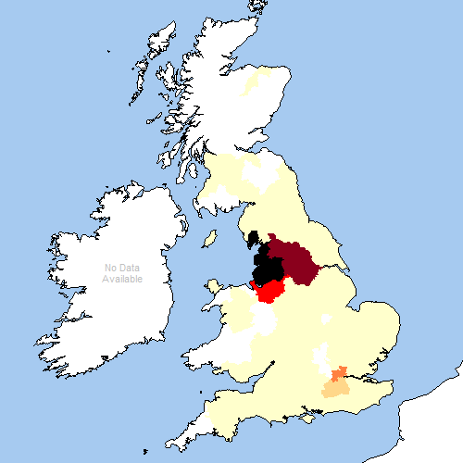
Monogenetic and a founder?
Butterworth – over 10,000,
mostly in Oldham
Suspicion falls on
Roger de Butterword,
recorded in the 13th-
century Lancs Whalley
Abbey Coucher Book

Slide 40
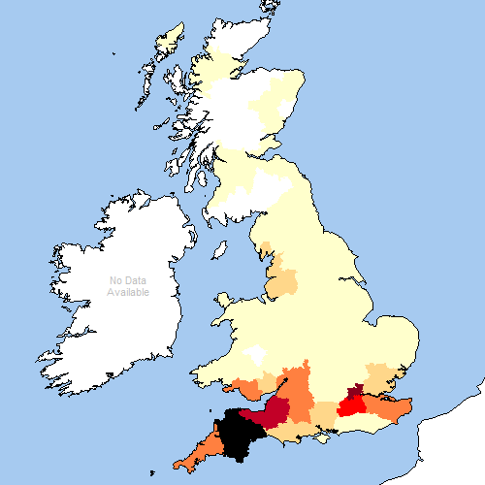
But even polygenetic names cluster
Tucker is now very
widespread, but still
clusters most strongly
in the south-west,
over 3000 in Devon

Slide 41
Further issues (if time permits)
What happens when related forms have drifted apart to the extent that they can only be linked philologically and not psychosocially?
Intense attachment of bearers to “their” version of a surname (Brown vs. Browne)

Slide 42
Fundamental problem in representing variation and its causes
Does one treat X as a variant of Y if there is an overlap in geographical distribution? Assumption: variation arises in situ, rather like variant pronunciations in classic variationist sociolinguistics based on neogrammarian views of change. Variation begins “under the radar”
Does one treat X as a variant of Y if they are separated in distribution? Assumption: variation arises where a name is unfamiliar in a new locality, rather like mangling foreign words in the process of borrowing. Variation begins “on the radar” and clerks battle with an unfamiliar phenomenon
[are these 2 things really so distinct?]
Easy to say both things probably happen
[Blackshire cf./ctrst Brokenshire] Flamson Honeysett Lipton/Lepton

Slide 43
Further issues (if time permits)
Issue of monogenesis
Issue of non-mobility
Issue of priority of toponymic over topographical terms (Northfield vel sim.)
Issue of first EBs out of place: Cureton; Potton in IGI lists
Late recorded variants (Huckerby~ Hucklesby)
Very lates: Ledgeway

Slide 44
Unexplained 1
1324 entries contain the word unexplained
Sometimes for lack of relevant knowledge
Allotey, Beschizza, Dhillon, Hua (5)

Slide 45
Unexplained 2
Many of these have at least one full explanation: Doust, Totten)
Some give a pretty good explanation but admit some (minor) aspect of it is unexplained (Candlin, Hollingsworth)
Many of these unexplaineds are fully discussed (Dungey, Kibblewhite, Strugnell, Sussams)
Others are not: Kinchin, Piff, Virgin
Some explanations I think have been missed: Pressdee, Tincknell. To be sorted out in FaNUK2!

Slide 46
Unexplained 3
Apparent toponymic surnames for which no place-name is known: Bosomworth, Fingleton, Hannaby
Strategy: (1) keep looking, especially for DMVs – depends on good toponymic surveys; (2) assume “corruption” (esp. in relation to unstressed second elements)

Slide 47
Advances
Advance 1: Selection of masses of evidence for inclusion (strongly evidence-based)
Advance 2: Modern and up-to-date: surnames of relevance to “consumers”
Advance 3: Improved connections medieval names/modern names

Slide 48
Work still going on for FaNUK2 (leading to second edition of dictionary)
Update recent-evidence baseline to about 2011
Reduce threshold down to 20 bearers; already many of these done as variants of headforms in FaNUK1
Add ulterior etymologies of FNs from place-names and from personal names where possible
More generally: clear up the unexplained!

