Slide 1
A natural history of proper naming in the context of emerging mass production
Richard Coates
University of the West of England, Bristol
Moscow City University, 19 September 2019

Slide 2
Abstract
There is a pattern in the history of proper names in new categories of nameables. Firstly two tracks of names emerge: one involving new essentialist names, and the second adapted from names of things in other, conceptually related, categories. Thirdly, there is a trajectory towards increasing arbitrariness in naming within each category.
This tendency is illustrated using selected onomastic data from the history of railway locomotives, small private businesses and rock music groups. The illustrative material is mainly British, or at least Anglophone, but a testable claim of universality is suggested for the pattern presented.

Slide 3
Key idea – an onomastic journey
A new category of thing is invented which it is thought suitable to give proper names to
Firstly (1) essentialist names appear, that is, names which literally reflect actual characteristics of the new things named
and (2) names are adapted from names of existing things in other, related, categories – a kind of metaphorical usage
These two are in some sort of balance
Thirdly, there is a trajectory towards increasing arbitrariness, that is where the names do not necessarily relate conceptually to the (new) things named

Slide 4
A model
I shall first demonstrate this using the case of the naming of British steam railway locomotives before 1846 …
… then show more briefly that the trajectory also applies in other categories of name …
… then articulate a general principle of naming practice.

Slide 5
A brief history of the conveyance of people in Britain (and Europe generally!)
[Wagons/wains/carts: for local freight]
17th/18th C coaches – private, but also public (the mail/post)
18th C canals – slow, and essentially for longer-distance freight
19th C railways – conceived for freight, adapted for passengers

Slide 6
A typical mail-coach

Slide 7
London-Cambridge

Slide 8
The fatal compromise

Slide 9
Types of bestowed name
Names were bestowed on some regular (mail) coach services (ambiguity between machine and service)
Commemorative or appropriated names (i.e. adopted or adapted from elsewhere) – Diligence (from French carrosse de diligence ‘fast coach’) > dilly; also names borrowed from other nameables: Courier (typically a newspaper title), Mercury (god of travellers and messages)
Essential or descriptive names (made up for the named object itself) – Birmingham Flyer (the typical commercial coach name), Red Rover, (metaphorically) Quicksilver (also allusion to Mercury)

Slide 10
Quicksilver – the last survivor

Slide 11
Also more oblique (indirect) names, but relating to the same ideas
Tally-ho (from foxhunting call)
Foxhunting was the main entertainment of rich country gentlemen in the 18thC-19thC
Tally-ho was the call to start riding fast after the fox
Tally-ho was signalled by blowing a horn, as were the start and approach of the coach

Slide 12
Locomotives
Products of the Industrial Revolution, from early 1800s onwards
Need to distinguish individual machines, which were made experimentally by different engineers - no standardization
At first distinguished by name rather than number (which came with mass production
Analogy: the horse (with coach) as power of transport; the locomotive similarly
They were given names which were, like those of the mail coaches, sometimes commemorative but mainly essential, and therefore they started by overlapping with mail coach names

Slide 13
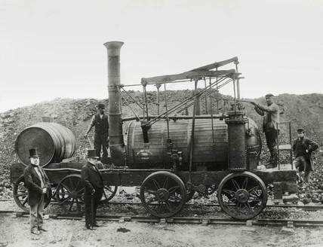
Commemorative or appropriated (1)
Of other modes of travel
Diligence >> Dilly, as in Wylam Dilly

Slide 14
Commemorative (2)
Of individuals and places in the news
Salamanca
Blücher

Slide 15
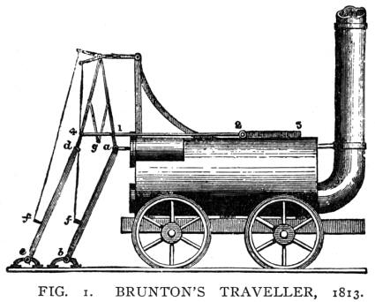
James Brunton’s Steam Horse (1813) – transitional, partly commemorative, essential

Slide 16
The sub-categories of essential or descriptive names for locomotives (1)
Names which designate a (perhaps “diabolically”) clever device of a particular kind, created by technological advance, producing novelty and (therefore symbolically) progress and superiority.
Names which allude to the literal outward signs of the new mechanical motive power, fire and steam, with coal as the source of the power, which also symbolized the mining environment in which many early locomotives were used.
Names which designate a device which is powerful. The prototypes of power were natural and dangerous: meteorological and animal.

Slide 17
1: Names which emphasize the cleverness of the device, producing novelty and (therefore) advance and superiority
By allusion to physical and perceptual characteristics
The Steam Horse (1813) and Steam Elephant (1815) where the collocations express the novelty, Cycloped (‘wheel foot’, 1829), Twin Sisters (1829; having two vertical boilers), Mountaineer (1834; a rack locomotive, i.e. one built to be capable of climbing)
By allusion to innovation
Experiment (1828 and 1833), Novelty (1829), Phoenix (1829 – actually constructed out of the parts of another engine? + allusion to fire), Success (1832), Patentee (1833), Pioneer (1837), Surprise (1838)
By metonymic allusion to industry in the widest (etymological) sense
Agenoria (1829), Perseverance (1829), Industry (1832), Yn Barod Etto (1832 – Welsh translation of familiar tag Semper paratus (motto of the Clifford family)/ Ever Ready)
By allusion to the black arts (witchcraft, sorcery)
Lancashire Witch (1828), Hecate (date uncertain)

Slide 18
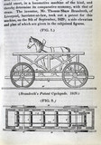
Brandreth’s Cycloped (1829)

Slide 19
2: Names which allude directly to coal, fire and steam and the motion that they cause
Directly
[Puffing Devil (1801)], Puffing Billy (1813-14), Steam Elephant (1815) and other already mentioned, Locomotion No. 1 (1825), Black Diamond (1826; = ‘coal’, the source of motive power), Firefly + others alluding to fire, including Spit Fire (1832-)
By metonymic/metaphorical allusion to generators of fire/noise, whether natural phenomena or the supernatural cause of these
Wildfire (1829), Lightning (????), Vesuvius (????), Vulcan (1831), Thunderer (1837), Sun (????), Vesta (????)
[Note the subcategory of classical references.]

Slide 20
3: Names which designate a device which has great power
By metaphorical allusion to natural power and its implicit danger
Steam Elephant (1815), Stourbridge Lion (1828), L’Éléphant (1836), Shark (1837), Lion (1838), Tiger (1838), Eagle (1838), Snake (1838), Viper (1838), Elephant (????), De Arend, De Leeuw (1839-40)
By classical or biblical allusion to powerful characters
Atlas (1833/4), Goliath (????), Samson (1837), Hercules (????), Vulcan (1831-2), Fury (????), Hecate (????), Ajax (1832), Hector (1834), Cyclops (????)

Slide 21
The five categories of essential name (2)
Names which designate a device which moves rapidly. The prototype of speed was flight, and the available prototypes of speedy transport were the (race)horse and the mail-coach, themselves often named from speedy weapons such as the arrow (source of metaphor).
Names which designate a device which is excellent; a vague term but with clear implications. Excellence permits pride, the conventional sources of which were in the family pride deriving from nobility (the wealth of nobility allowing patronage), and in the national pride deriving from the successes of military heroes.
Names also reflected the newer notion of pride developing in the form of the local civic pride of the new industrial cities, and also pride in individual foundries and engineers.

Slide 22
4: Names which designate a device which is speedy or ready for action
Directly
Catch me who can (1808), Active (1825), Swiftsure (????) – also name of a ship of the line serving at the Battle of Trafalgar (1805), Alert (1837)
Indirectly, by metaphorical allusion to speedy objects, including the wind (“like the wind”) and the mail-coach
Wylam Dilly (1813-14), Dart (1822), Star (1822), Tallyho (1822), Diligence (1826), Wildfire (1829), Meteor (1829), Arrow (1829), Rocket (1829), Perseverance (1829 – if a pun on Diligence), Lightning (????), Red Rover (1833), Hurricane (1837), Zephyr (1841-2), Sirocco (1841-2), Swallow (1841)

Slide 23
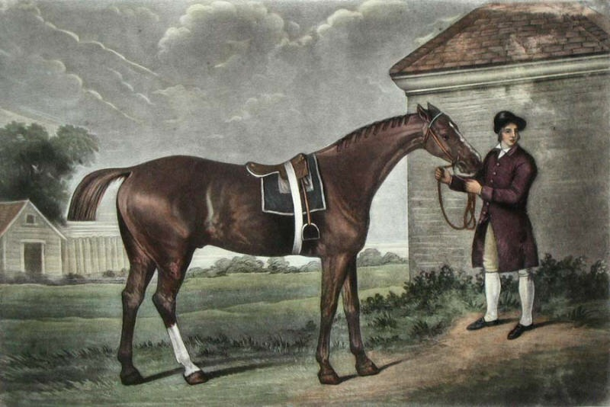
Eclipse

Slide 24
5: Names which designate a device which is “excellent”
By description or allusion to currently accepted high standards, including moral ones
Sans Pareil (1829), Perseverance (1829), Success (1832), Premier (????), Alpha (????), ?? Great A (1845)
By allusion to royalty and nobility
Prince Regent (1812), Lady Mary (1813-14), ?The Duke (1817), Royal George (1827), Earl of Airlie (1833), Victoria (1838 and 1840)
By allusion to military power and prowess
Salamanca (1812; after Wellington’s victory in the Peninsular War), Lord Wellington (1813-14), Blücher (1814), The Duke (1817; = Wellington), Victory (1828; after the flagship of Trafalgar?), ? Invicta (1829; on one level: Latin ‘unconquered’), Dreadnought (1830; after an early-19th century ship, but also literal allusion to heroism), Belted Will (1839)
By allusion to the place of manufacture (or to their engineers) or to the place of deployment, expressing local pride
Wylam Dilly (1813-14), Killingworth (1816), Pride of Newcastle (1827), Stourbridge Lion (1828), Northumbrian (1829), Invicta (1829 – reference to the county motto of Kent), Liverpool (1830), Manchester (1830), Union (1831), Stephenson (1832), Warrington (1832), Newton (1832), Vulcan (1832), Caledonian (1832), Dowlais and others (1832-), Jacob Perkins (?1836), Charles Jordan (1838), Soho (1839)
this type extended to symbols of national pride with Britannia (1829) and John Bull (1831)

Slide 25
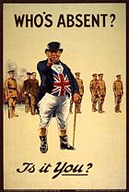
John Bull

Slide 26
My claim
The dominant early naming strategy (apart from naming-after, or commemorative naming) was to bestow essential names on the individual, often unique, machines

Slide 27
New naming strategies can be shown to emerge from seeds in the old one
These can be seen to result in the new type of mass commemorative class-naming which later became dominant – the classes have names which are rooted in the types of individual name that were bestowed (naming after places, people …)
The process involved is refocusing, defined as permitting classes to become name-sources through switching from commemoration of a prominent representative example to commemoration of any member of that class, whether especially prominent or not
Some examples of railway locomotive classes: castles (> other buildings), hunting packs, racehorses, football clubs, countries of the Empire, kings, saints, war heroes, directors of the railway company, characters in literature …
Essential names eventually disappear; class naming is guided by earlier practice but not limited by it ….

Slide 28
Evolution of naming practices in general
The names of the first examples, the unique or experimental prototypes, will strongly tend to have names playing on essential characteristics of the objects themselves.
Often this will involve transferring names from other categories of nameable seen to provide analogies of some kind.
Eventually, the prototype machines may give way to mass-produced instances, as a result of which the classical essential features are no longer salient or remarkable.
Then, individualization is necessary for successful reference, but there can be advantages in thematic naming; as a result, name-classes emerge which are permitted by prominence switching to characteristics of the class rather than of the individual (> e.g. any deity (not just of industry), any king (not just good ones).

Slide 29
Testing the idea (1): Early rock music bands
The Crickets, The Jordanaires, The Drifters, The Shadows, The Rolling Stones, The Four Tops, The Doors, The Herd; The Band*, The Blue Notes*, The Merseybeats*, The Yardbirds
Amen Corner, Humble Pie, Canned Heat, The Lovin’ Spoonful, The Who, Mott the Hoople, Procol Harum

Slide 30
Testing the idea (2): small businesses
Named either from their founder or proprietor (W. H. Smith, Marks and Spencer, John Lewis), or in a way which evoked directly the kind of trade they were engaged in (County Fishery, The Rubber Man).
More recent business names have had names which are, or appear to be, arbitrary (Waitrose, Wavy Line, Somerfield, Asda, Tesco, Londis, Spar, Aldi, Lidl).

Slide 31
Testing the idea (3): Place-names in general, also street-names in particular
? Originally topographical only
Then metonymic use of topographical names/terms
Then habitatives
Then commemoratives
Then entirely arbitrary

Slide 32
General law of the evolution of name-bestowal?
As examples of similar nameable entities multiply, the strategy of name-bestowal shifts from essential (descriptive) and individually commemorative (appropriated) to class- or type-based commemoration, and the link between form and what is denoted in bestowed names becomes increasingly arbitrary.

Slide 33
That’s all, folks!

